Slide 1
Software Testing
Code-Based Data Flow Testing
Presented By
Ning Chen, Ph.D.
Professor
Department of Computer
Science
California State University,
Fullerton
© Ning Chen, 2017
*

Slide 2
Module Objectives
This module focuses on the Code-Based Data Flow Testing

Slide 3
Slice-Based Testing
Another way of tracking data that flows through the program is called slice-based testing.

Slide 4
What?
The first logical question is - what is the slice-based testing?

Slide 5
Observation
Let’s begin with an observation.
[A Survey of Program Slicing Techniques by Frank Tip] gives the following program example:

Slide 6
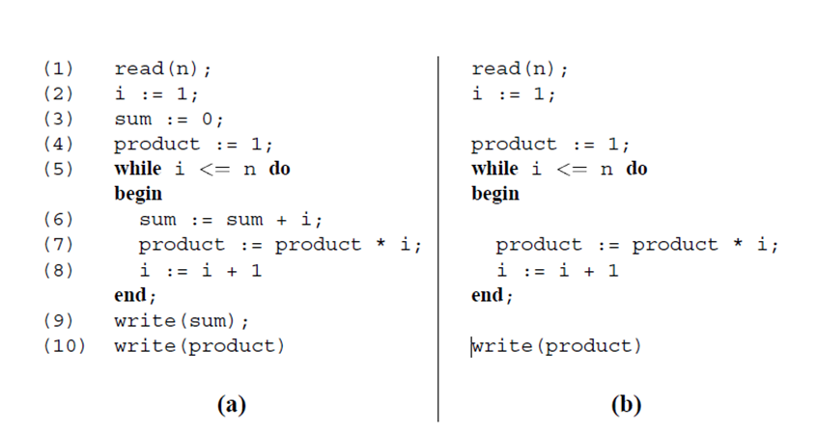
Observation

Slide 7
(a) is just a typical program under test. (b) is a subset (or called slice) of program (a) if we only want to analyze the flow of the variable product all the way from the beginning to line 10. Our first observation is that this slice is obtained by “slicing away” all computations not relevant to what happens to the variable product at line 10. The second observation you may have is that program (b) is a reduced, executable program obtained from program (a). Why do we want to do this? The original proposer [Weiser 1984] who advocated the concept of program slicing claims that it is much easier to debug a program if you view it as a collection of multiple slices. Each slice is smaller and simpler than the original program. It is not that hard to accept this claim. In a way, it is just another form of “divide-and-conquer.”

Slide 8
Next Logical Question
How?
You may say, by inspection, we have no problem to get program (b) from program (a) given a criterion of (variable product and line 10). For simplicity, we want to write this criterion as S (V, n)① where V represents a specific variable we are interested in, or a set of variables if we really want to handle multiple variables simultaneously②, n stands for the program line location③ where we start our investigation.

Slide 9
Continued
① We use S to represent a criterion since a given criterion will produce a slice (or a collection of slices if we want to handle more than one variable at a time).
② Although it is possible to handle multiple variables simultaneously, in a typical scenario, we really prefer to handle one variable at a time.

Slide 10
Continued
③ Once you determine the line location, you start examine all the statements starting from that line location backward to the beginning of the program. This is the reason why in some literature people call it backward④ slicing.

Slide 11
Continued
④ Since we have backward slicing, do we have forward slicing? The answer is yes. Another line of research actually focused on the program statements that are affected by the variable V only after the line location n. This means you examine the program forward starting line location n all the way to the end of the program. It is called forward slicing.

Slide 12
Static Vs. Dynamic
Notice that in the above discussion we didn’t consider any pre-defined input values. To highlight this fact, we may call our slicing as static slicing. Can we add some pre-defined input values in our criterion? The answer is yes and one more research line actually does that. In this case, we call our slicing as dynamic slicing.

Slide 13
Concerns
A method that is based solely on inspection is not scalable. Are we going to inspect a program with more than thousand lines? Our question on “how” needs to focus on a systematic way of turning a given program into some desirable slices. Once we found a systematic way, for sure, we can produce an automatic software tool to do the chores.

